Slide 1
First-Week Conclusion
ZHIQING ZHONG
AUGUSTUS

Slide 2
Texas Holdem
Texas hold 'em (also known as Texas holdem, hold 'em, and holdem) is a variation of the card game of poker. Two cards, known as the hole cards, are dealt face down to each player, and then five community cards are dealt face up in three stages. The stages consist of a series of three cards ("the flop"), later an additional single card ("the turn" or "fourth street"), and a final card ("the river" or "fifth street"). Each player seeks the best five card poker hand from any combination of the seven cards of the five community cards and their own two hole cards. If a player's best five-card poker hand consists only of the five community cards and none of the player's hole cards, it is called "playing the board". If you play the board on the river, then you can do no better than tie the other player(s) in the game if no player can make a better hand than the board represents, using either or both hole cards. Players have betting options to check, call, raise, or fold. Rounds of betting take place before the flop is dealt and after each subsequent deal.

Slide 3
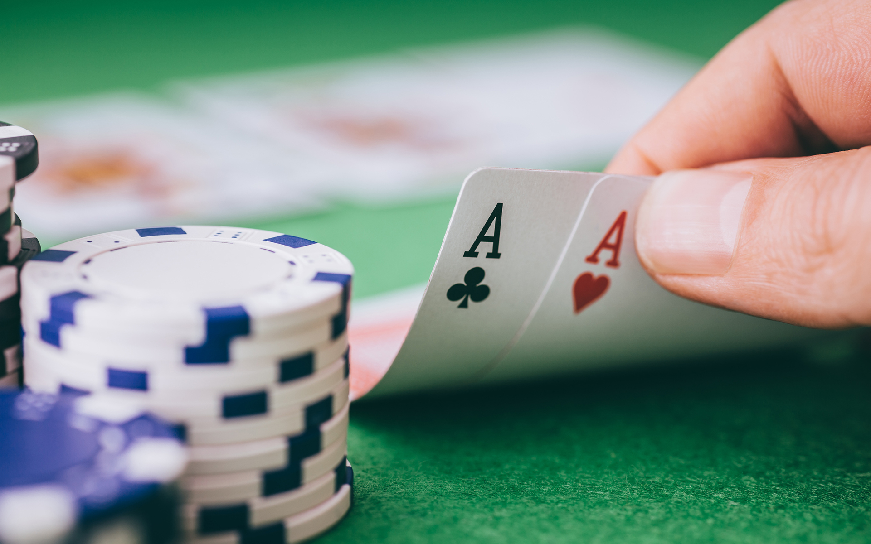
The Goals
AI might help players make a better decision
Money should be wined as much as possible
Money should be lost as less as possible

Slide 4
The difficulties
Information is not sufficient
Possibilities are various
Training models are hard to build
Training data is hard to find
Algorithms are complexly used

Slide 5
I have already done...
Set the training data of the detection
Building the software and hardware environment on windows to do the machine learning (GPU- ACCELRATE)
Card detection (using opencv)
System camera is used
Improvement of using picamera

Slide 6
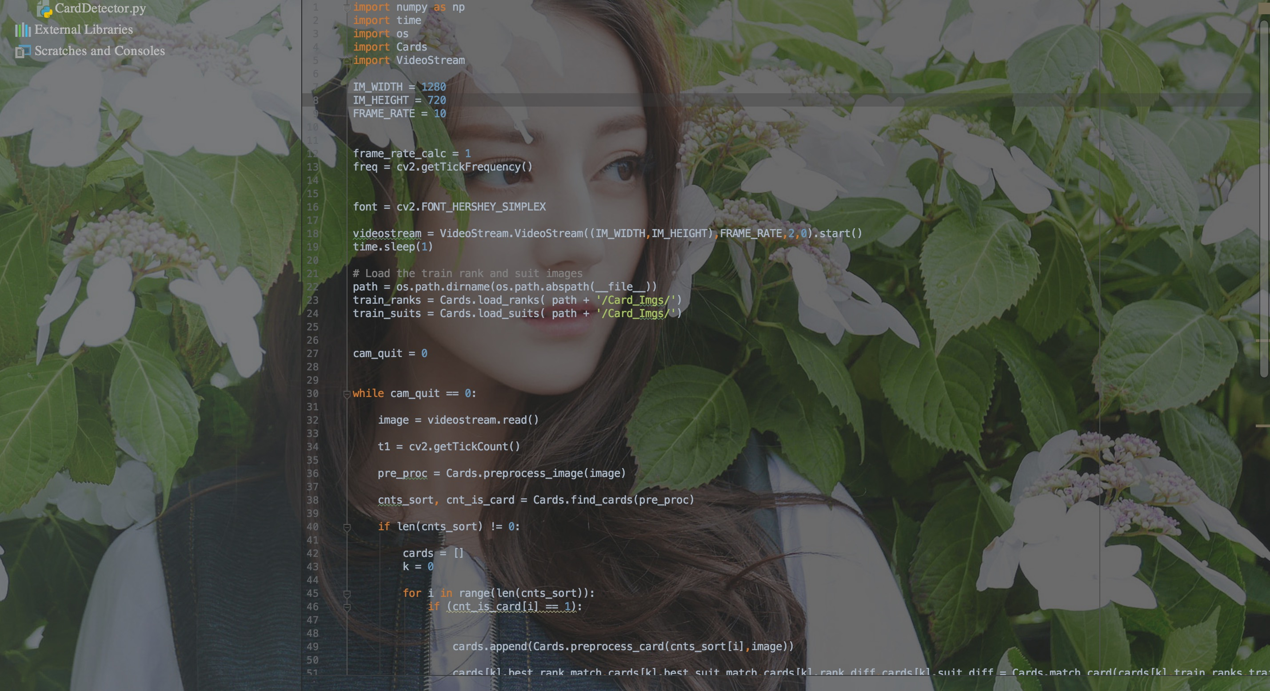
Appendix

Slide 7
I am doing...
Trying to select the algorithms to fixed the problems
Building the neutral network models
Finding the open sources data to training models

Slide 8
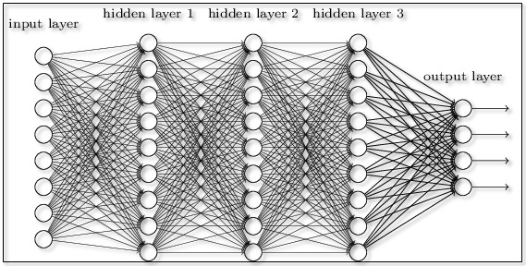
MODELS(Neural network/Decision trees(NO USE OF Markov chain)
WHAT I AM THINKING...
1
0
0
0
0
1
0
0
0
0
1
0
0
0
0
1

Slide 9
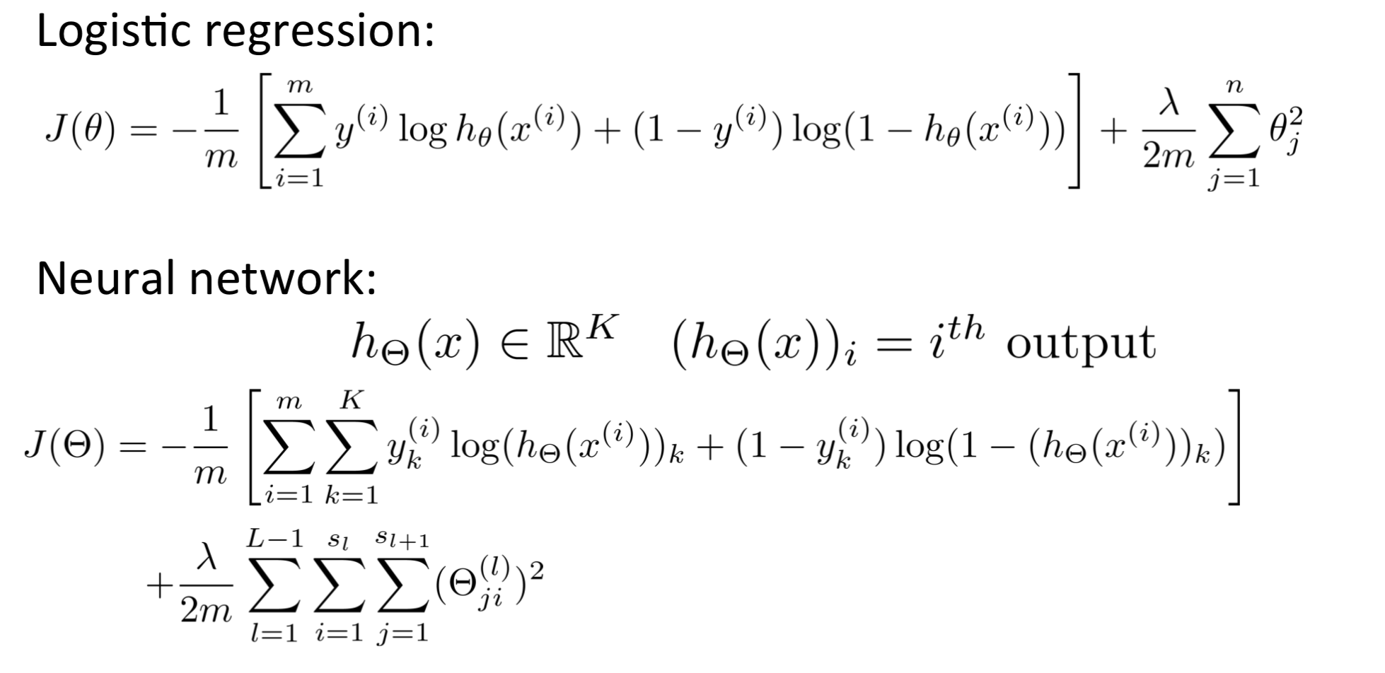
Cost function for neural network

Slide 10
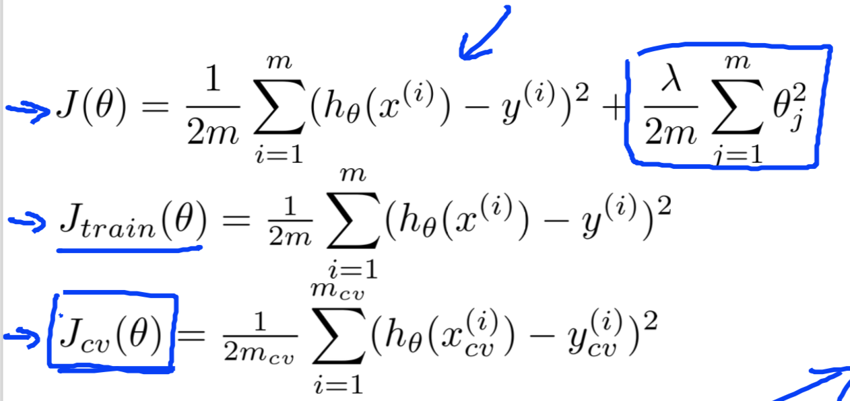
Learning functions

Slide 11
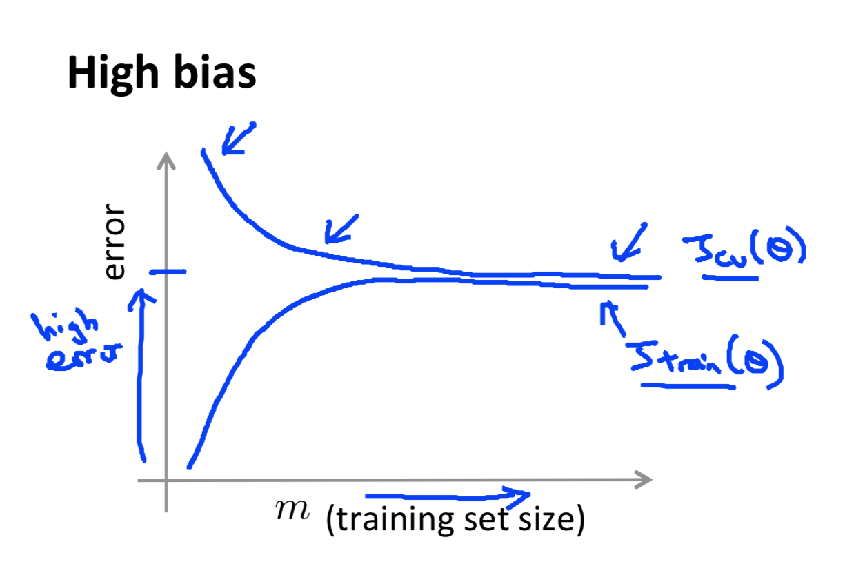
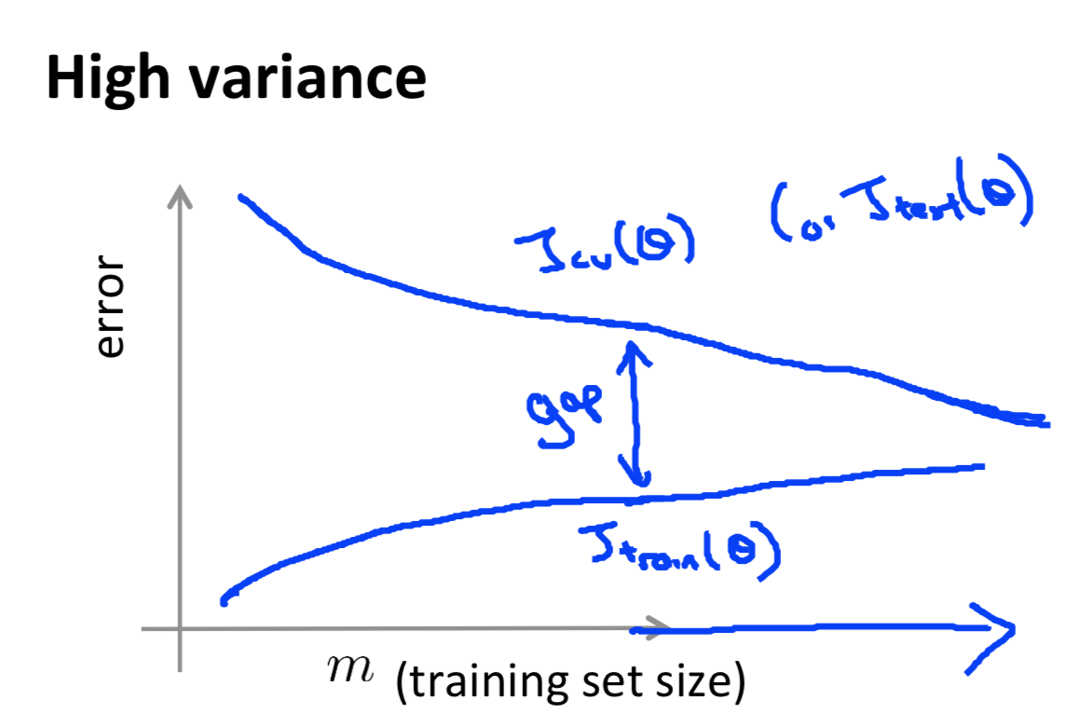
High bias? High variance ?

Slide 12
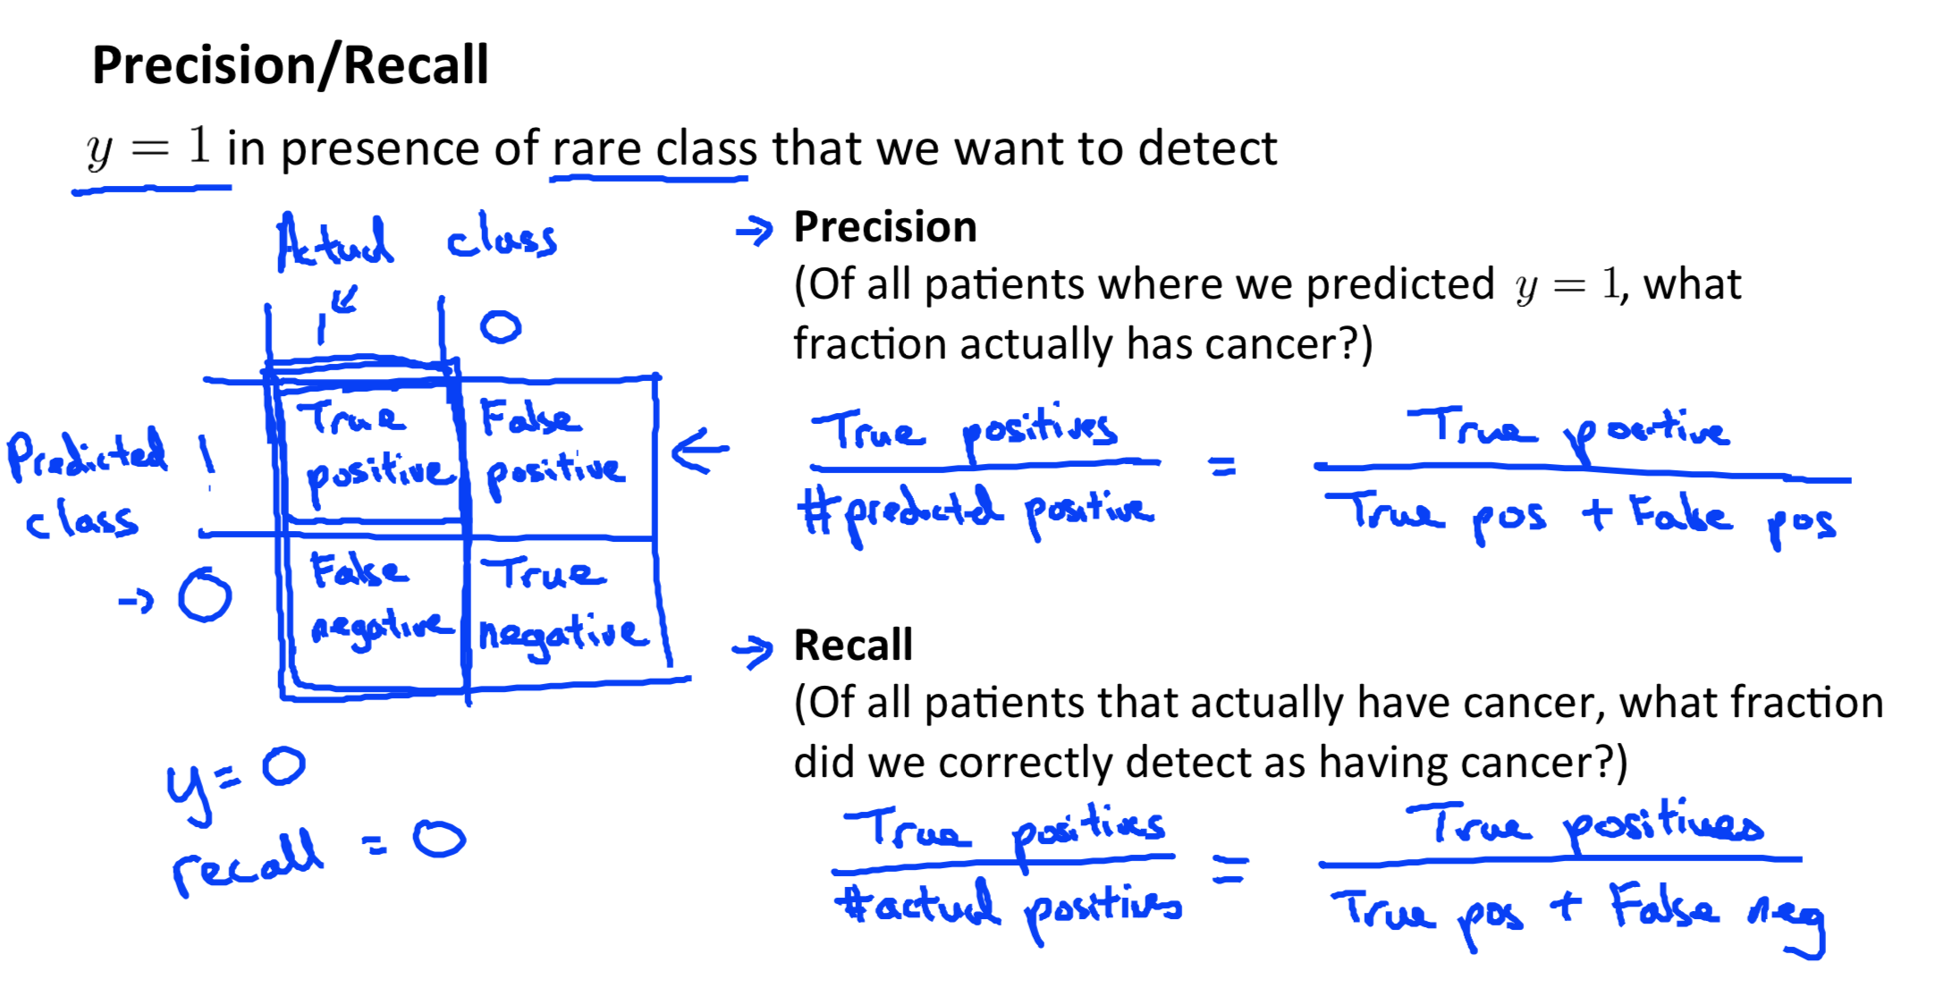
Resulting choosing

Slide 13
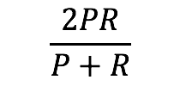
F1 score
$$\frac{2PR}{P+R}$$
F=
IF (P=0 OR R=0)
F=0
IF (P=1 AND P=1)
F=1
So, the higher F1 score, the resulting is better

